Slide 1

Stress detection in Students
by
Sai Priya C
Roll No. 214G1A3291
Purushotham B
Roll No. 214G1A3281
Neha C
Roll No. 214G1A3268
Tharun K R
Roll No. 214G1A32B3
Under the guidance of
Dr. P. Chitralingappa _{M. Tech., Ph.D.}
Associate Professor & Head Dept. of CSE(Data Science)
Department of Computer Science and Engineering (Data Science)
Srinivasa Ramanujan Institute of Technology
(Affiliated to JNTUA & Approved by AICTE) (Accredited by NAAC with ‘A’ Grade & Accredited by NBA (EEE, ECE & CSE)
Rotarypuram Village, B K Samudram Mandal, Ananthapuramu – 515701.
2024 - 2025

Slide 2
Abstract
This study leverages machine learning to detect stress in students using physiological and behavioral data such as heart rate variability, sleep patterns, physical activity, and academic workload. Data is collected through wearable sensors, self-reports, and digital activity logs, then processed by models like Support Vector Machines, Random Forests, and Neural Networks to classify stress levels into low, moderate, or high categories. The system helps monitor stress in real time using mobile apps or academic portals and offers personalized stress management tips. Preliminary results demonstrate high accuracy, suggesting its potential to enhance student mental health, academic performance, and overall well-being.
Keywords:Stress, Machine Learning Algorithms, Wearable Sensors

Slide 3

Contents
Abstract
Problem Statement
Objectives of Project
Literature survey
Proposed Work
Introduction
Existing System
Proposed System
Planning
Requirements
UML Diagrams
Implementation
Data Flow Diagram
Data Processing Techniques
Sample Code
References
GitHub Link
Queries

Slide 4
Problem Statement
Stress is a critical factor that affects the personal and professional life of students. Detecting the emotional state of students experiencing stress is essential for ensuring their mental health and overall safety. To address this, our system leverages advanced image processing and machine learning techniques to identify stress levels in students accurately. By analyzing specific indicators, the system can provide early detection and intervention to support students in managing their stress effectively. However, these methods need to be tested in real-world situations to ensure they work well, are practical, and are reliable. This report focuses on understanding how these automated methods can detect stress effectively and how to make them more accurate and useful.

Slide 5
Objectives of Project
Develop a Machine Learning model to predict stress levels based on collected data.
To build a model for emotion recognition from facial expressions, including emotions such as happiness, sadness, anger, and surprise.
To design and implement a stress level prediction model based on physiological features such as snoring range, respiration rate, body temperature, limb movement, blood oxygen levels, eye movement, hours of sleep, and heart rate.
To integrate emotion detection and stress level prediction into a unified system, processing real-time input from a webcam and physiological sensors.
To develop a user-friendly frontend with a Flask backend that enables seamless interaction and real-time feedback.
To test the system’s effectiveness in different environments, assessing its reliability in monitoring and predicting stress levels and emotions.

Slide 6
Literature survey
S.NO | JOURNAL | AUTHORS | TITLE | OUTCOME
1 | 9th International Conference for Convergence in Technology,(I2CT) 2024 | Ashutosh Singh, Khushdeep Singh, Amit Kumar | Machine Learning Algorithms for detecting Mental Stress in College Students | The study highlights the highest accuracy in stress classification reaching 95% using machime learning models
2 | Published by Elsevier Ltd | Ravinder Ahuja, Alisha Banga | Mental Stress detection in University Students using Machine Learning Algorithms | The paper concludes that the SVM algorithm outperforms other classification methods in assessing stress levels using the Perceived Stress Scale (PSS), with potential to improve mental health through more accurate methods.
3 | International Journal of Research Publication and Reviews | Ms. Ancy Paul, Ms. Resija | Stress Detection in College Students Using Machine Learning Algorithm | The paper presents a machine learning model that classifies college students' mental stress levels with 99% accuracy using Random Forest, and suggests applying the model to other groups while exploring real-time stress detection via images, videos, wearable sensors, and social media posts.

Slide 7
Cont..
S.NO | JOURNAL | AUTHOR | TITLE | OUTCOME
4 | IEEE Access, May 24, 2021. | SHRUTI GEDAM SANCHITA PAUL | A Review on Mental Stress Detection Using Wearable Sensors and Machine Learning Techniques | The paper shows that wearable sensors like HR and GSR are effective for stress detection using machine learning techniques like SVM and Random Forest. Future research should improve their accuracy, affordability, and practicality for real-time use.
5 | International Research Journal of Engineering and Technology (IRJET) | Rohini Hanchate, Harshal Narute, Siddharam Shavage, Karan Tiwari. | STRESS DETECTION USING MACHINE LEARNING | The paper presents a system designed to assess and quantify stress levels in individuals, providing results in percentage format to raise awareness about mental health. It aims to help individuals manage and reduce stress during long work sessions by offering real-time updates and alerts, promoting proactive well-being practices

Slide 8
Proposed Work
In this Project we will use Machine Learning to identify stress level in the students and to predict the stress earlier so that we can able to stop the major damage to their life before happening.
In the test, we will evaluate students amongst different situations. the level of stress was approved by the undertaking execution.
The proposed model includes PSS dataset collection , pre processing , feature extraction and applying machine learning algorithms.
Raw Data -> Pre-Processing of data -> Applying different classification algorithms -> Output.

Slide 9
Introduction
Stress is often associated with negative experiences or events. However, research shows that stress is a natural part of life.
Some common causes of stress Work-Related Stress, Academic Stress, Financial Stress, Personal Relationships, Health-Related Issues.
Every hour, a student commits suicide in the different part of the country. Our country has reported large suicide cases of the youngsters aging between the age group of fifteen to twenty nine, as per Lancet report(2012).
Number of suicide in our nation are increasing Consistently around 92 individuals commit suicide around the world, which makes it 800,000 for every year. Out of this 135000 (17%) are an inhabitant of India.
We will study how these factors affect people's minds using brainwave signals collected from the PSS dataset.

Slide 10
Existing System
PSS-Based Stress Classification: Some systems use PSS and similar scales, along with demographic and behavioral data, to predict an individual’s stress level. These systems typically employ machine learning algorithms such as Naive Bayes, Logistic Regression, and SVM to process responses and generate predictions.
Manual Techniques
Surveys :Widely used to assess stress levels through self-reported responses.
Examples: Perceived Stress Scale (PSS)

Slide 11
Proposed System
The proposed system utilizes real-time face recognition.
It detects age, gender, and emotions from facial images. Convolutional Neural Networks (CNNs) are used for emotion and gender detection.
DeepFace library is used for accurate age estimation.
The system processes images in real time via the webcam.
It can predict stress levels based on dataset features.
It runs as a Flask web application with a user-friendly interface.

Slide 12
Requirements
Hardware:
Processor - I3/Intel Processor
Hard Disk - 160GB
Key Board - Standard Windows Keyboard
Mouse - Two or Three Button Mouse
Monitor - SVGA
RAM - 8GB
Software:
Operating System : Windows 7/8/10
Programming Language: Python
Libraries : Pandas,Tensorflow, Keras,Flask
IDE/Workbench : VS Code
Technology : Python 3.8+

Slide 13
Implementation
Dataset:
The dataset used in this project taken from Kaggle consists of man and woman images. Each image corresponds to a facial expression in one of seven categories (0=Angry, 1=Disgust, 2=Fear, 3=Happy, 4=Sad, 5=Surprise, 6=Neutral).
This dataset contains 631 records, each representing an individual's physiological data, with the goal of predicting their stress level. The dataset includes features such as snoring range, respiration rate, body temperature, limb movement, blood oxygen levels, eye movement, hours of sleep, and heart rate. These features are continuous measurements that describe different aspects of a person's physical state. The target variable is the stress level, which ranges from 0 to 4, where 0 indicates no stress and 4 represents very high stress.

Slide 14
Cont..
Convolutional Neural Network (CNN)
A Convolutional Neural Network (CNN) is a deep learning model primarily used for image classification and recognition tasks. It consists of several layers, including:
Convolutional layers: These layers apply filters to the input image, extracting features like edges, textures, and patterns.
Pooling layers: These layers reduce the dimensionality of the image, preserving important features and reducing computational complexity.
Fully connected layers: After feature extraction, the CNN uses these layers to classify the image based on the learned features.
Output Layer: This layer is responsible to produce the final output.

Slide 15
Cont..
Training: The CNN model is trained using a labeled dataset of facial images. The model learns to associate facial features with corresponding emotions (e.g., happy, sad) and gender (male, female).
DeepFace Library: For age detection, the project utilizes the DeepFace library, which provides pre-trained models for age estimation. DeepFace employs several state-of-the-art deep learning architectures, including VGG-Face, Google’s FaceNet, and OpenFace. The pre-trained model leverages transfer learning to predict age based on facial features.
Model Inference: Once the face is detected, the image is passed to DeepFace’s age estimation model. DeepFace performs facial feature extraction and maps the extracted features to a specific age group (e.g., 0-2, 3-7, 8-15, 16-25, etc.).
Age Prediction: The model outputs a predicted age group for the detected face. Unlike direct age prediction (which outputs a continuous age value), this approach provides an age range, which is often sufficient for applications like demographic profiling

Slide 16
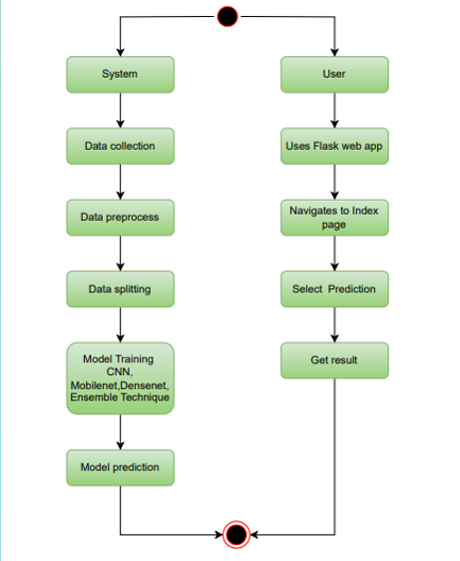
UML Diagrams
This is an behavioral diagram that
illustrates the flow of
control or data through a
series of activities or actions
in a system. It represents
the dynamic aspects of a
process, including decision
points, parallel activities,
and the sequence of
operations. Activity
diagrams are useful for
modeling workflows and
business processes.

Slide 17
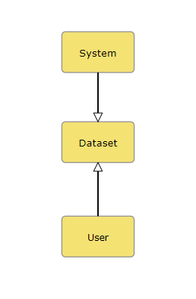
Data Flow Diagram
A Data Flow Diagram (DFD) shows how information moves in a system.
It helps visualize system requirements in a clear way.
A DFD can represent manual, automated, or mixed systems.
It shows how data enters, exits, changes, and where it is stored.
The main purpose is to define the system’s scope and boundaries.
It helps communicate between system analysts and users.
It is useful for redesigning and improving systems.

Slide 18
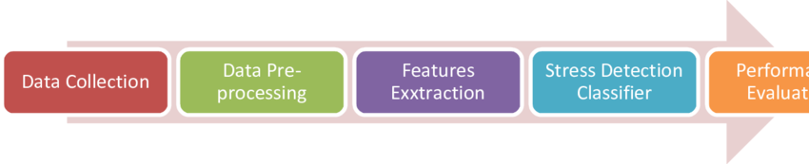
Data Processing Techniques
Data Collection: Gather data from various sources like sensors, surveys, or images to represent the problem (e.g., physiological signals, facial expressions, or text responses).
Data Preprocessing: Clean and prepare the collected data by handling missing values, scaling features, and removing irrelevant or noisy information.
Feature Extraction: Identify and extract key attributes (e.g., heart rate, voice tone, or text sentiment) that are most relevant for stress detection
Stress Detection Classifier: Use machine learning algorithms (e.g., SVM, Decision Trees, or Neural Networks) to classify whether a person is stressed or not based on the extracted features.
Performance Evaluation: Assess the classifier's accuracy, precision, recall, and F1 score using metrics like confusion matrix

Slide 19
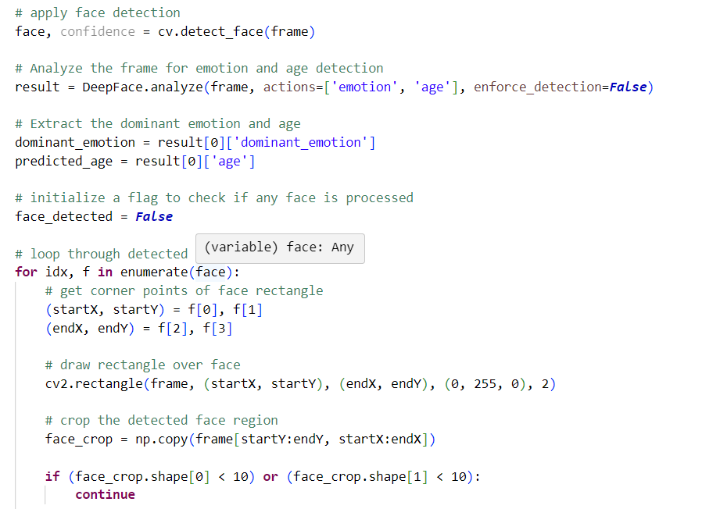
Sample Code
For face detection.

Slide 20
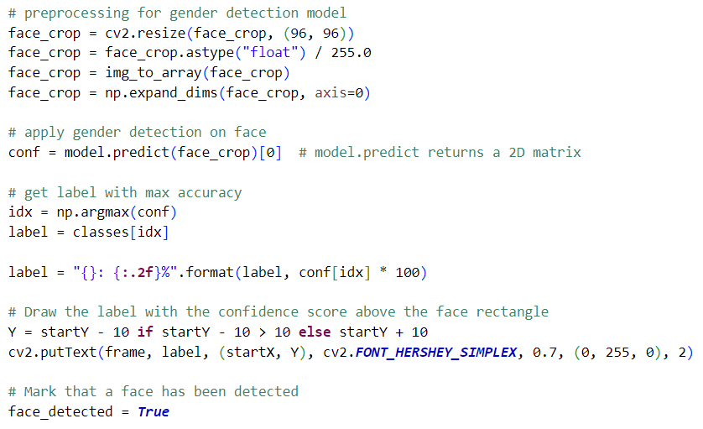
Sample Code
Identifying the gender.

Slide 21
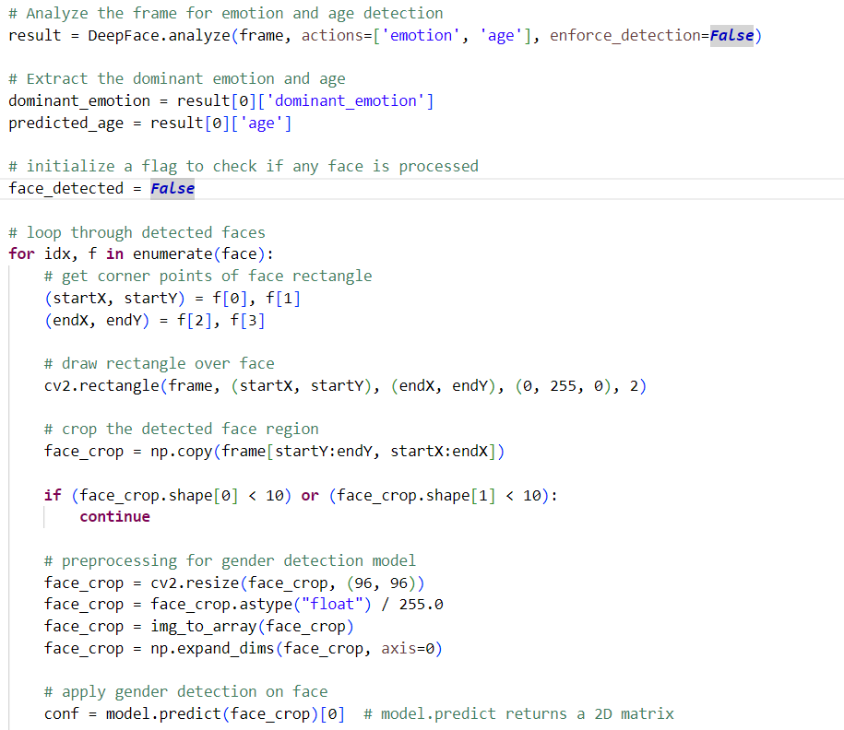
Sample Code
For emotion and age detection.

Slide 22
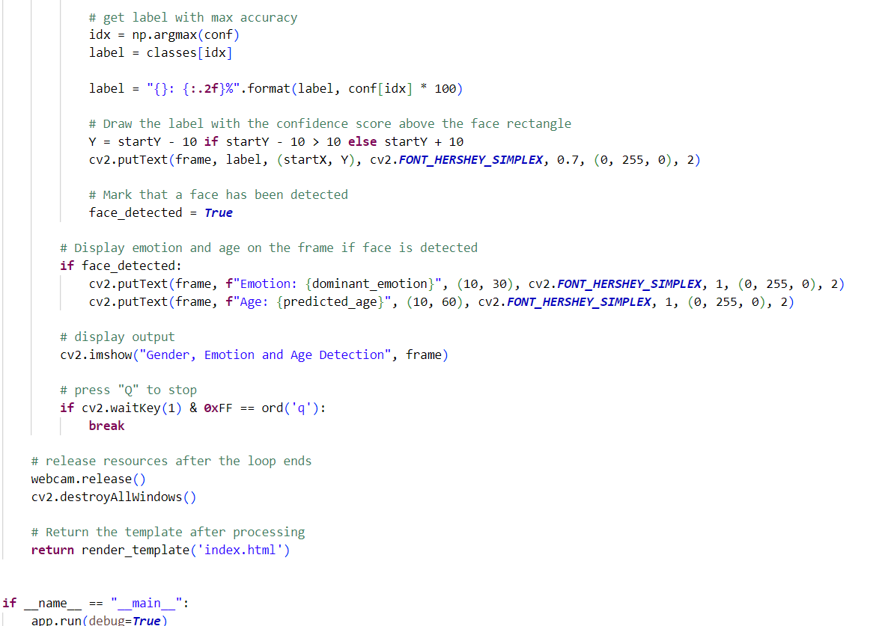
For emotion and age detection.

Slide 23
Reference
[1].Ravinder Ahuja and Alisha Banga, “Mental Stress detection in students”,Elsevier Ltd , vol. 11, pp. 349-353, Jan. 2019.
[2].Arsalan, Aamir, Syed Muhammad Anwar, and Muhammad Majid “Mental stress detection using data from wearable and non-wearable sensors: a review.”
[3] S. A. Singh, P. K. Gupta, M. Rajeshwari, and T. Janumala, ‘‘Detection of stress using biosensors,’’ Mater. Today, vol. 5, no. 10, pp. 21003–21010, 2018.
[4] J. Ogorevc, A. Podlesek, G. Geršak, and J. Drnovšek, ‘‘The effect of mental stress on psychophysiological parameters,’’ in Proc. IEEE Int. Symp. Med. Meas. Appl., Bari, Italy, May 2011, pp. 294–299

Slide 24
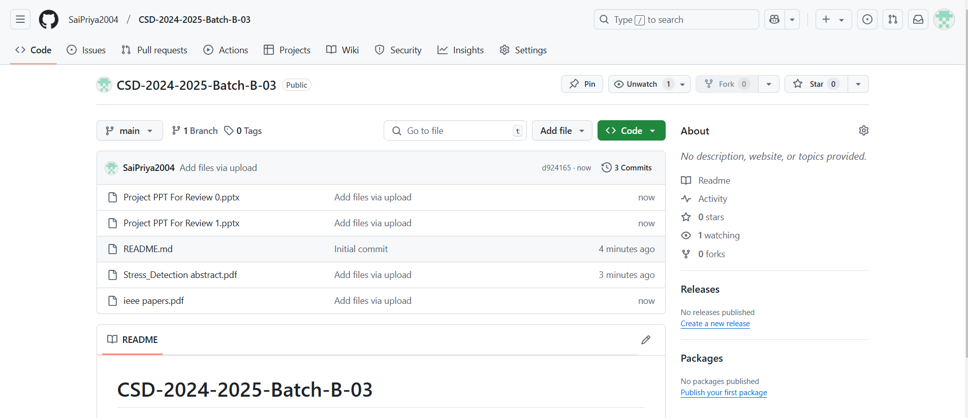

Git Hub Dashboards of each student

Slide 25
Any Queries?

Slide 26
Thank You!!!

